Slide 1
Devi Ahilya Vishwavidyalaya
Computer Centre
Welcomes
NAAC Peer Team Members
January 15-17, 2014
Dr. D. S. Bhilare
Head Computer Centre
head.cc@dauniv.ac.in

Slide 2
Outline
Background
Objectives
Existing Infrastructure
Staff
Activities
Future Plans

Slide 3
Background
Established in 1986 by UGC
Amongst the first ten Computer Centres in India [First in Madhya Pradesh]
Initiated MCA Programme in 1986 [ One of the few centres selected by UGC]
Installed ICIM 6000 in 1986 for training, research and University result processing
DRDO provided a Main-Frame for for research computing in 1989[CDC Cyber 180/830]

Slide 4
Vision
To be in forefront in building state-of-art infrastructure to facilitate effective teaching, research and administration in the University
Mission
To facilitate IT related activities and Education in the University.

Slide 5
Objectives
  Facilitate and develop state-of-art IT infrastructure in the university.
  Assist in all e-Governance Initiatives in the University.
  Teaching in MCA, M.Sc., M.Tech., Ph.D. programmes and active involvement in research

Slide 6
Organization Structure
HEAD
SCS&IT
Systems Analyst
Computer Operator
Data Entry Operator
Systems Engineer
Systems Manager
Programmer
Maintenance Engineer
HEAD
Computer Centre
HEAD
IT Centre

Slide 7
Existing Infrastructure
Servers: Three Windows based Servers
Print Servers : Three
High Speed Line Matrix Printers:
  Lipi 6312L: 1000 LPM
  Lipi T6100: 800 LPM
  Lipi MT661: 600 LPM
Hosts: 25, Laser Printers: 5
Innovation Centre having 241 Computers at SCS & IT, New Building
Online UPS: Eight Hours Power Backup
Generator: 50 KVA Generator [Shared]
Notes:
Printing load is very heavy so heavy duty line printers are required.

Slide 8
Lab Infrastructure
SCSIT Server Room (New Building) Innovation Center
Research Lab
Network and Security Lab (DST FIST)
CC Server Room (Old Building)
Data Processing Centre
Language Lab (Sponsored by UGC)
Data Mining Lab(UGC SAP)
MCA Lab, BCA Lab, M Sc Lab, M Tech Lab,
Centre For E-management

Slide 9
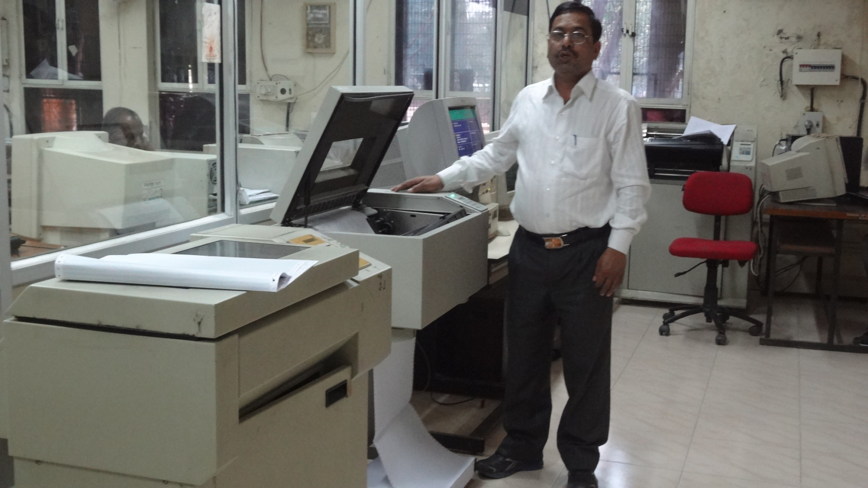
Printer Room

Slide 10
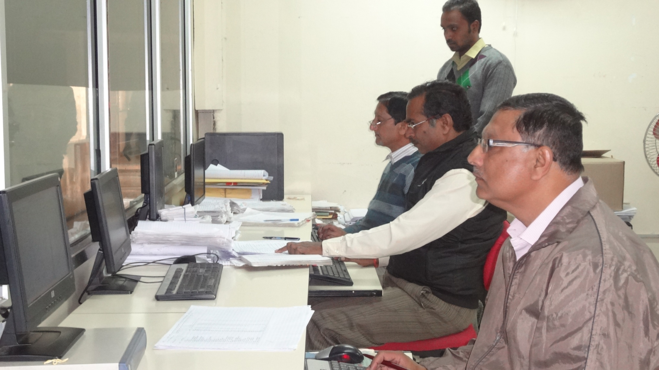
Data Processing Section

Slide 11
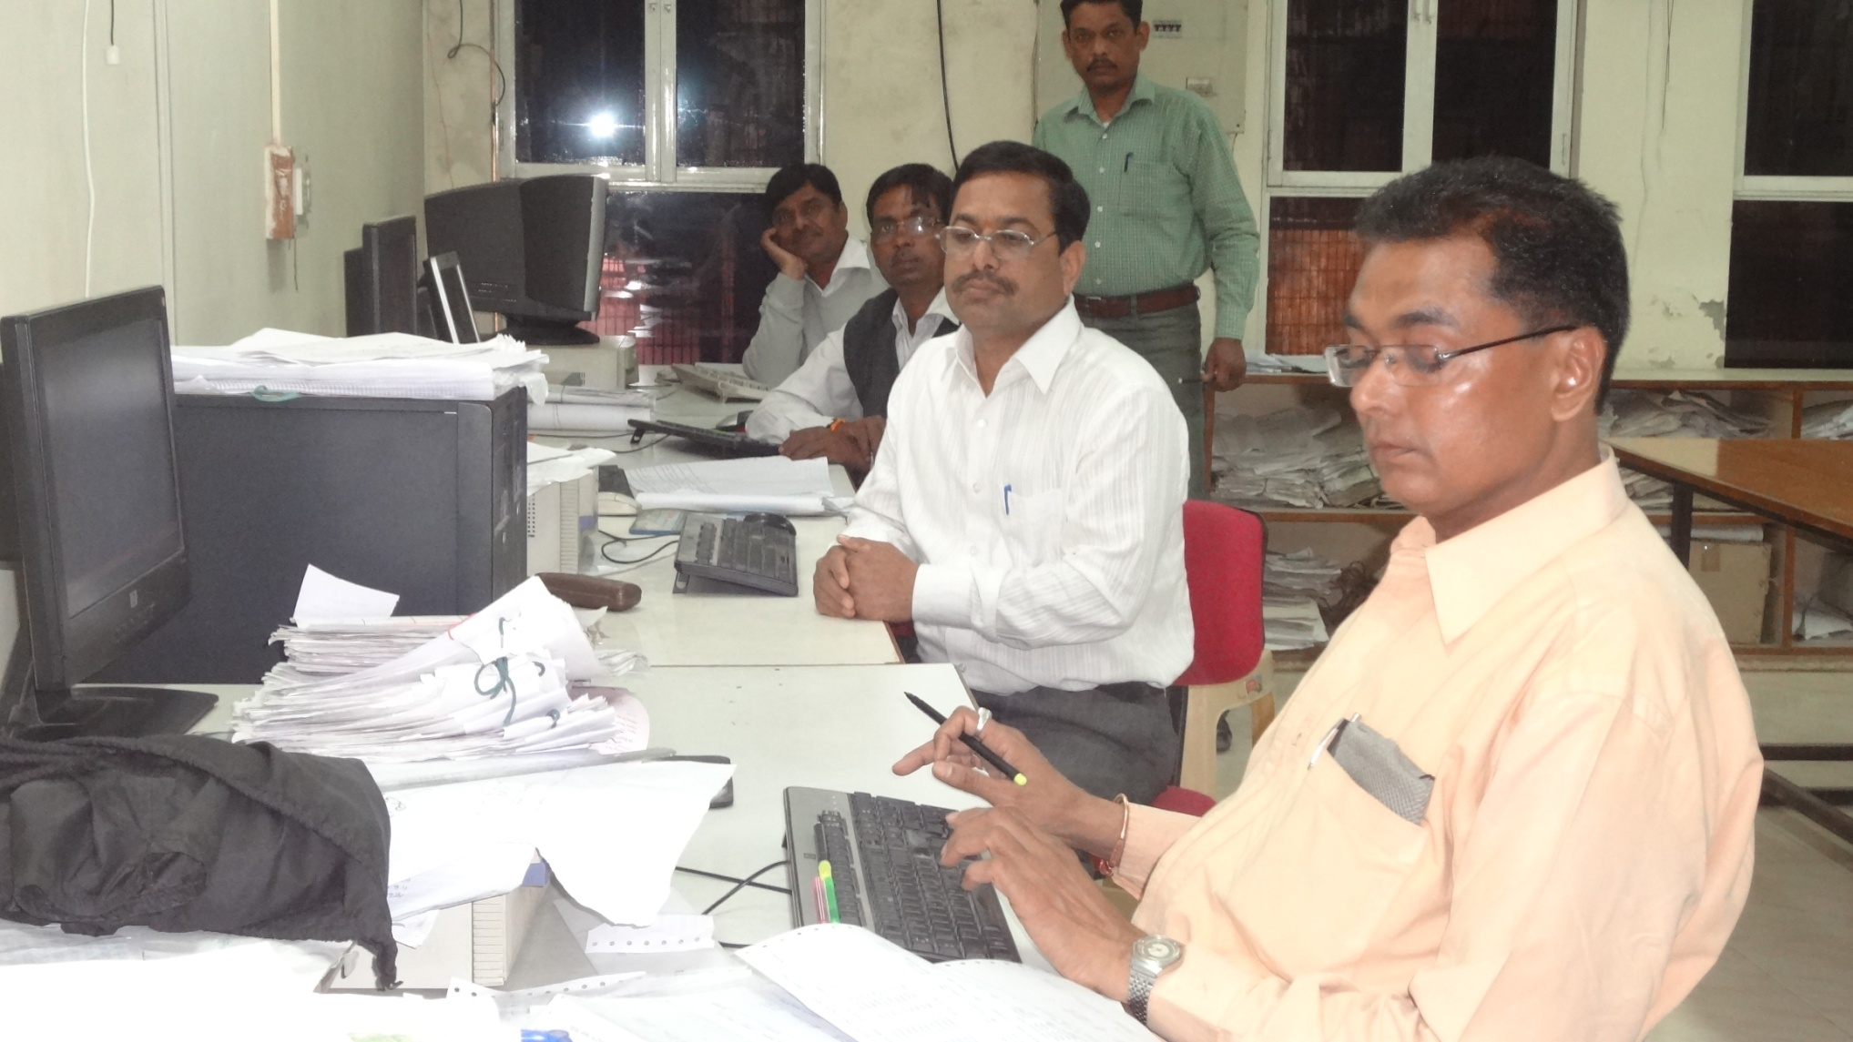
Data Processing Section

Slide 12
Staff
UGC Teaching Staff: [Three Posts Vacant]
Dr. D.S. Bhilare, Head CC & System Manager
Dr. Maya Ingle, Prof. & Sr. System Analyst
Dr. Priyesh Kanungo, Prof. & Sr. Sys. Engg.
Dr. Arvind Goyal, Asso. Prof & Sr. Prog.
Mr. Alok Tiwari, Programmer
Mr. Anand More, Jr. Maint. Engineer

Slide 13
Teaching Staff Profile
D.S. Bhilare , Head CC
M. Tech.(CS), M. Phil., CCAI, M.B.A., Ph. D. (CS)
Received a Patent, published over 30 research papers
Conference chair in conference at Chongqing, China
Presented paper in ACM Conference in St. Louis, U.S.A.
Guiding Seven Ph. D. students in Computer Science.
N.B.A. Expert committee member
Mrs. Maya Ingle
M. Tech. (CS) from IIT Kharagpur, Ph.D. (Comp. Sc.)
Eight Ph. D.s guided, guiding Six Ph.D. Students in Computer Science
Published over 80 research papers
Visiting professor in IIIT Jabalpur, IIT Indore,
UGC, AICTE & N.B.A. Expert committee member
Notes:
Patent Publication Date and Number: November 22, 2013, 3323/MUM/2013
Title of the invention: Method for improved Quality of Service in terms of priority and security at Transport Layer of TCP/IP Internet Protocol Suite

Slide 14
Teaching Staff Profile
Dr. Priyesh Kanungo
M. E. and Ph.D. in Computer Engg.
Two Ph. D.s guided, Guiding Five Ph. D. Students in Computer Science
Published over 40 research papers
Dr. A K. Goyal
M. Sc., MCM, Ph. D.
One Ph. D. guided, Guiding Three Ph. D. Students in Computer Science
Published one book and 15 research papers.

Slide 15
Teaching Staff Profile
Mr. Alok Tiwari : Programmer
MCA, pursuing Ph. D. in Computer Science
Published 15 Papers in Journals and Conferences
Mr Anand More: Jr. Maint. Engineer
M.C.A., M. Tech., pursuing Ph. D. in Computer Science

Slide 16
Operation Staff
Sr. Computer Operator [1]:
  Mr D L Verma
Computer Operators [3]:
  Mr Salil Telang, Mr Jeevan Chourasia, Mr Diwakar Khanwalkar
Data Entry Operators [4]:
  Mr Lalit Madloi, Mr Sanjay Shukla, Mr Sunil Pendharkar, Mr Kishor Nargave.
Staff on daily wage basis: 13

Slide 17
Activities
Result Processing
  Computer Centre processes results for various faculties: Arts, Commerce, Science, Home Science, Law, Management, Computer, Medical, Dental and other professional courses
  Total Number of Students : Approx. 1.7 Lakh
  Total Number of Colleges: 270
  Covers Undergraduate, Post Graduate Degree And Diploma Courses
  Total Number of distinct results per year: Approx. 450

Slide 18
Composition of UG & PG Students

Slide 19
Faculty Wise UG Students

Slide 20
Faculty Wise PG Students

Slide 21
Vital Statistics
Districts 8
Affiliated Colleges 270
Courses 150
Results 450
Students (UTD) 10,560
Students(Affiliated Colleges) 1,72,586
Total Transactions / Semester 2 Million

Slide 22
Activities Contd…
Result Processing: [Pre Examination Phase]
Online registration of students, generation of roll number and enrollment number
Online submission of fees, examination forms
Distribution of hall tickets, Roll List, Attendance Sheet
Generation of course wise/subject wise numerical return for paper printing and distribution
Online entry of Internal Marks and Absentee by colleges

Slide 23
Activities Contd…
  Result Processing: [Post Examination Phase]
  Preparation of Student & Course Database
  Entry and Verification of Theory, Internal and Practical Marks
  Data Validation and Query Attending
  Generation of Reports:
    Roll List, Numerical Return
    Tabulation Chart
    Result Sheet, Statistical Summary, Merit List
    Mark-sheet etc.

Slide 24
Activities Contd…
  Types of Results:
  Main, ATKT, Revaluation, Review and UFM Result Processing (Semester System)
  Private Student Results (Annual System)
  Results of University Teaching Departments: Based on Grading Pattern

Slide 25
Activities Contd…
Post Result Processing:
  Online Submission of Revaluation/Review Application and Fees
  Generation of Copy Viewing Schedule and Subject wise list of students for copy extraction
  Preparation of Revaluation, Review, Retotal and UFM results

Slide 26
Activities Contd…
  Payroll:
    Preparation of monthly salary of University employees and generation of various monthly & annual reports:
      Salary Slip
      Various Deduction Statements
      PF & Pension Statement
      Department Summaries
      Bank Statement, Tax Statement etc.
      Budget Preparation

Slide 27
Activities Contd…
Computer Centre is also involved in the following:
  Assisting various departments in selection of hardware, software and technology
  University e-Governance initiative
  Computer Awareness training to University Staff
  Organizing workshop for the colleges to provide training on use of Online Registration and Internal Marks Entry System (MP Online)

Slide 28
Academic Activities
  Since inception (1986), the Computer Centre teaching staff is engaged in the teaching and research activities in School of Computer science and Information Technology (SCS&IT).
  Computer Centre is also managing various advanced laboratories and projects (SAP & DST FIST) in the SCS & IT.

Slide 29
Future Plans
  Capacity Building to handle the additional load, which has been increased many fold due to the following reasons:
    Addition of new districts (Dhar, Jhabua, Khargone, Khandwa, Badwani, Alirajpur, Burhanpur)
    Increase in number of courses and students
    Introduction of semester system
    Annual System still exists
Notes:
Recruitment of additional staff (Data entry, Computer Operator, Programmers)
Additional Server/Desktops

Slide 30
Future Plans
  Replacement of existing servers / Printers
  Migration of existing software to latest platforms (Final testing is over, Parallel processing in progress)
  A contract has been signed with Security Press Nasik for printing degrees
  University Executive Council has approved the Pilot Project to implement end-to-end ICT Solution in Examination Process from 2014 session. Initially it will be implemented at Instt. of Engg. & Tech., DAVV.

Slide 31
Future Plans Contd.
Salient features of pilot project are:
End-to-End use of ICT
Question Paper Generation using Question Bank
Online Secure Delivery of Question Papers
OMR/ICR/Barcode based Answer Sheets
Digital Scanning and onscreen evaluation of Answer Sheets,
Degrees and Certificates in Demat form

Slide 32
Thank You
Dr. D. S. Bhilare, Head (Comp. Centre)
Devi Ahilya Vishwavidyalaya
Indore, India
head.cc@dauniv.ac.in
        bhilare@hotmail.com
        91-98266-06366

